Slide 1
Tuto SimCLR

Slide 2
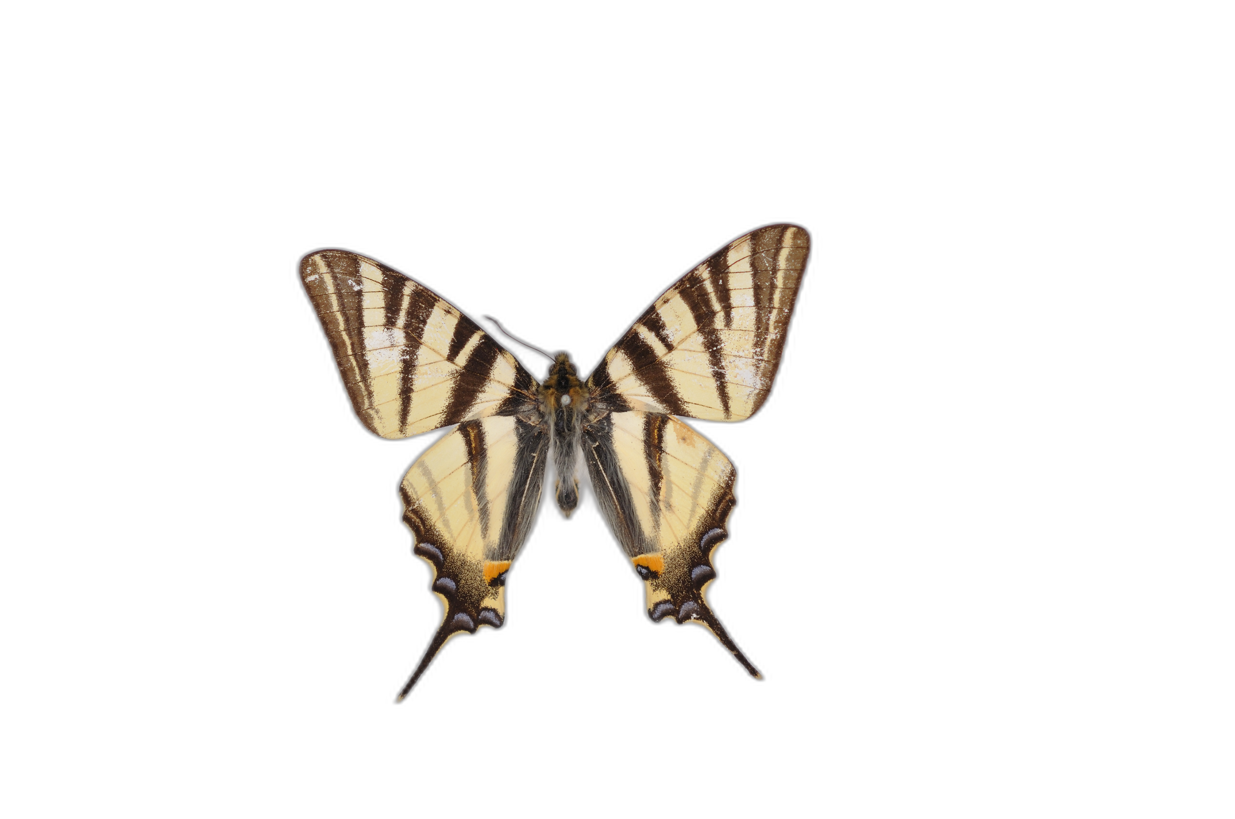
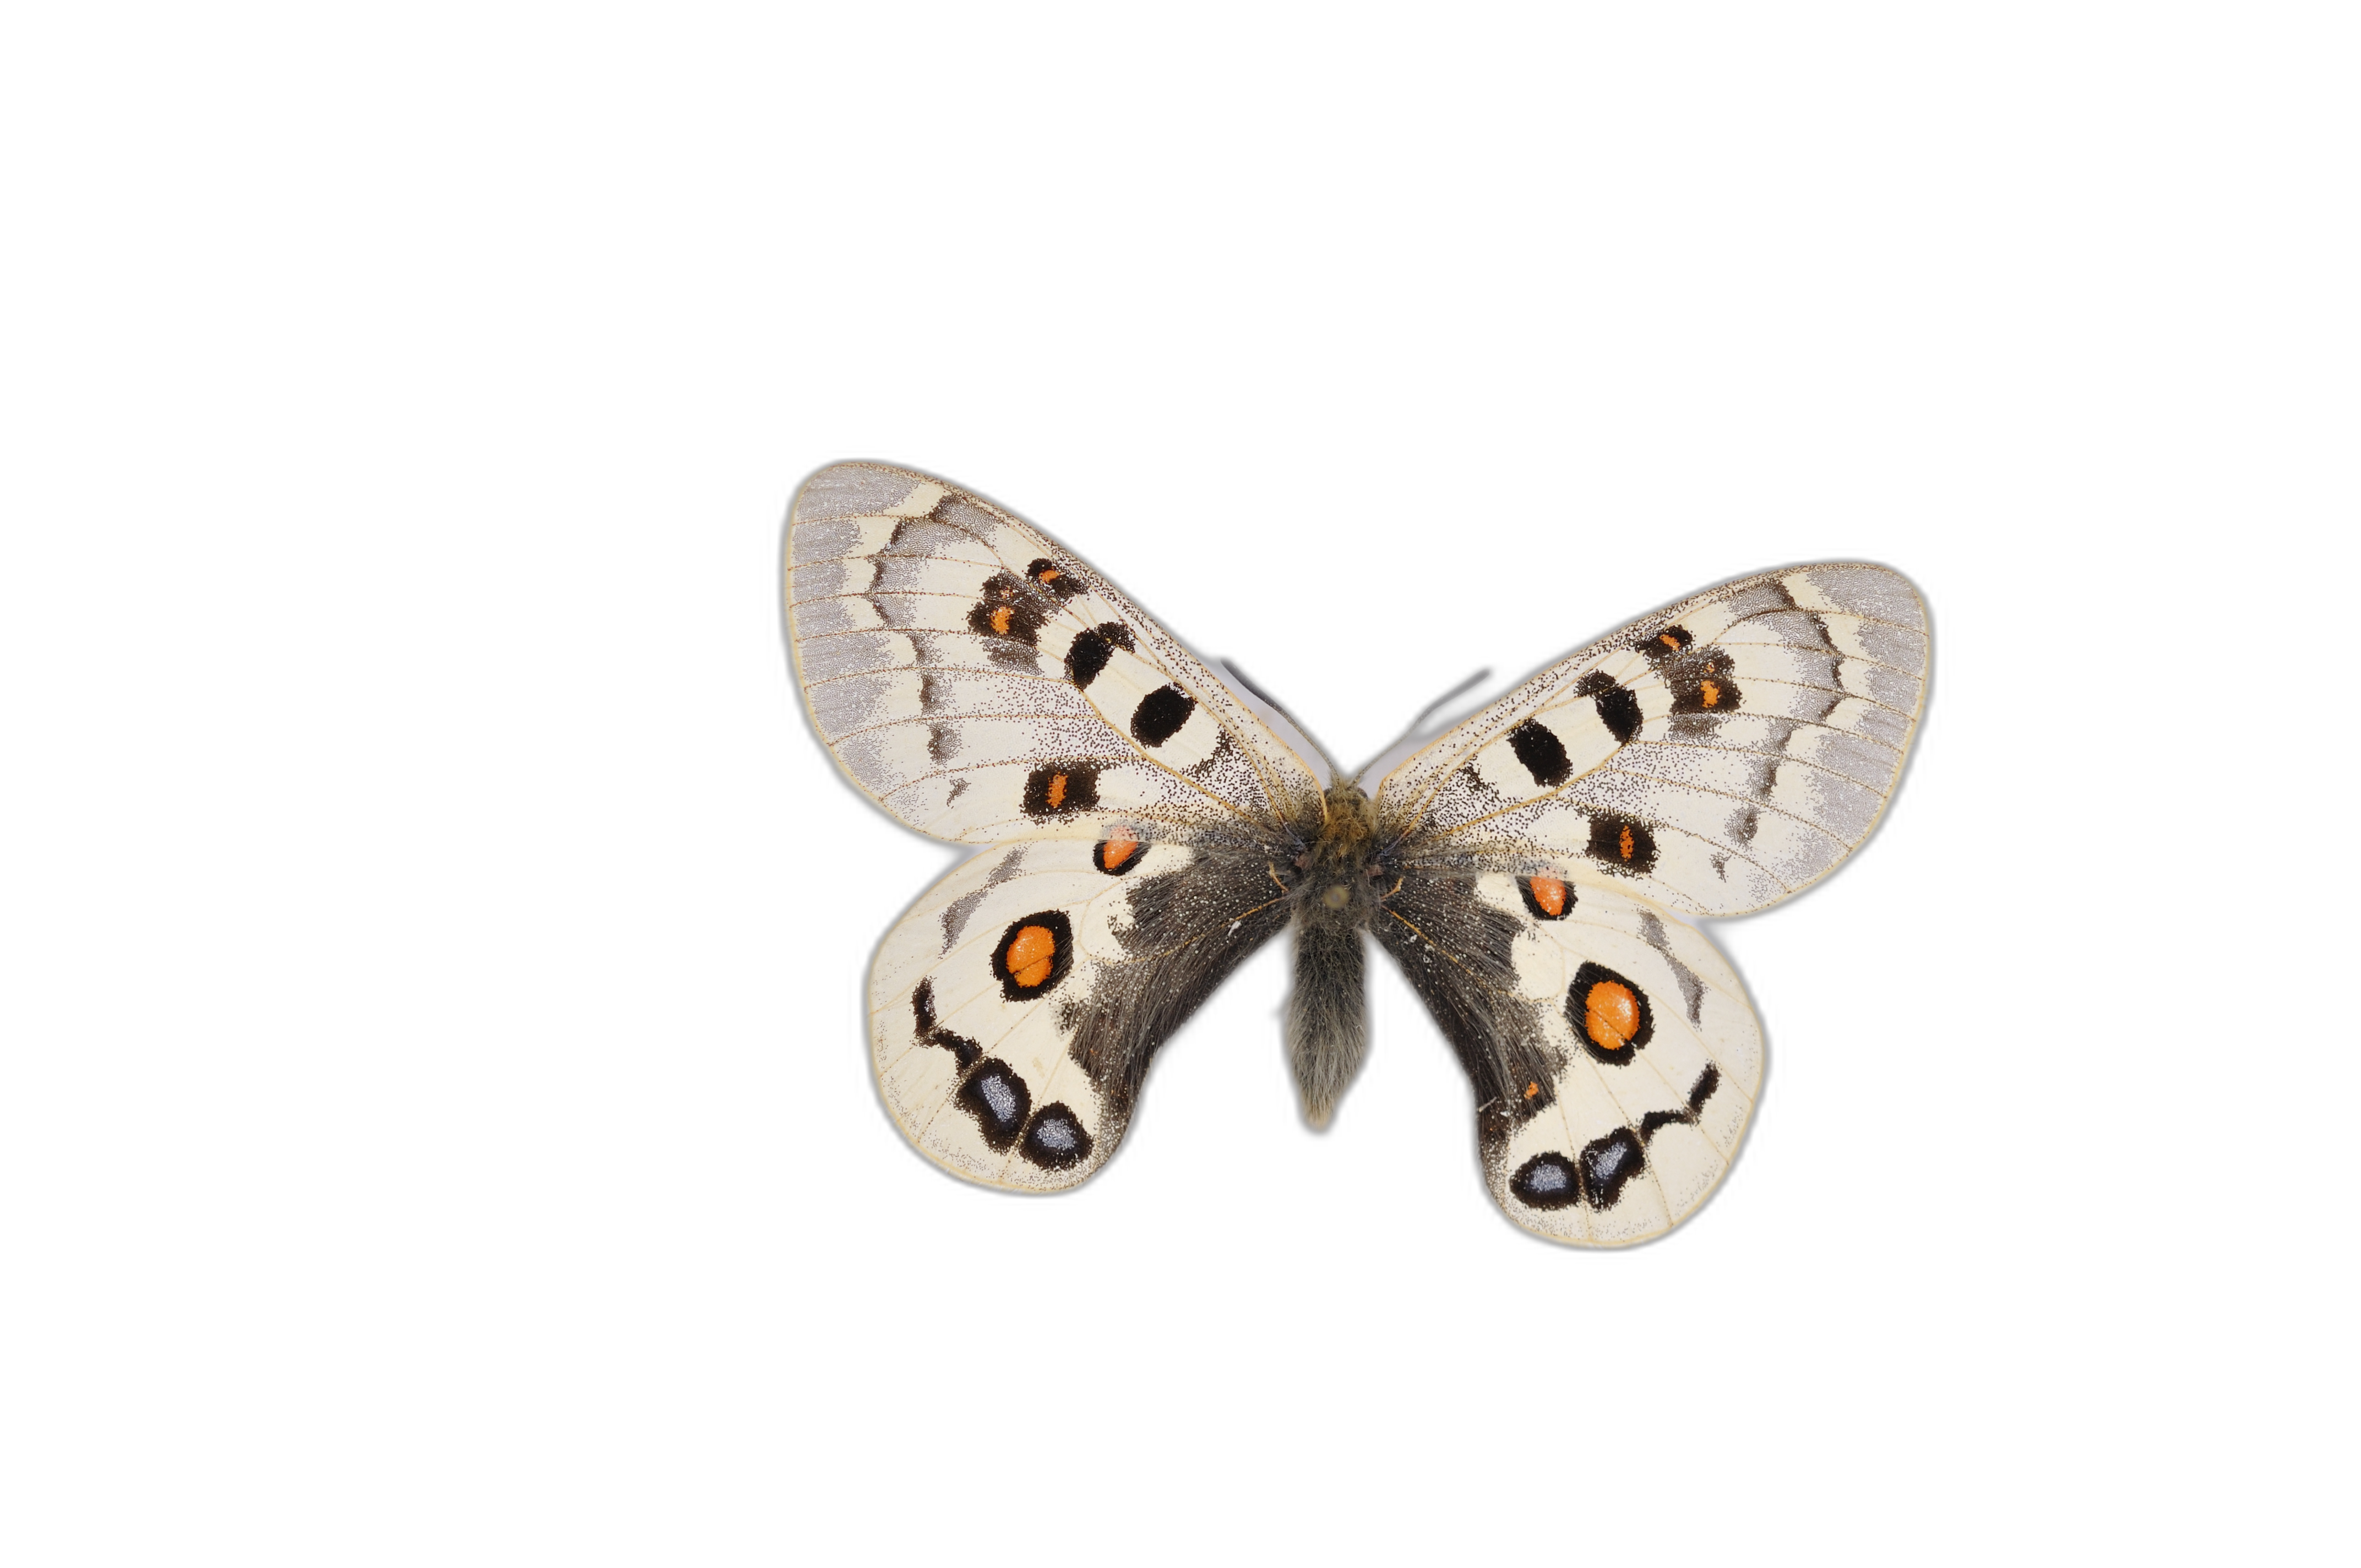
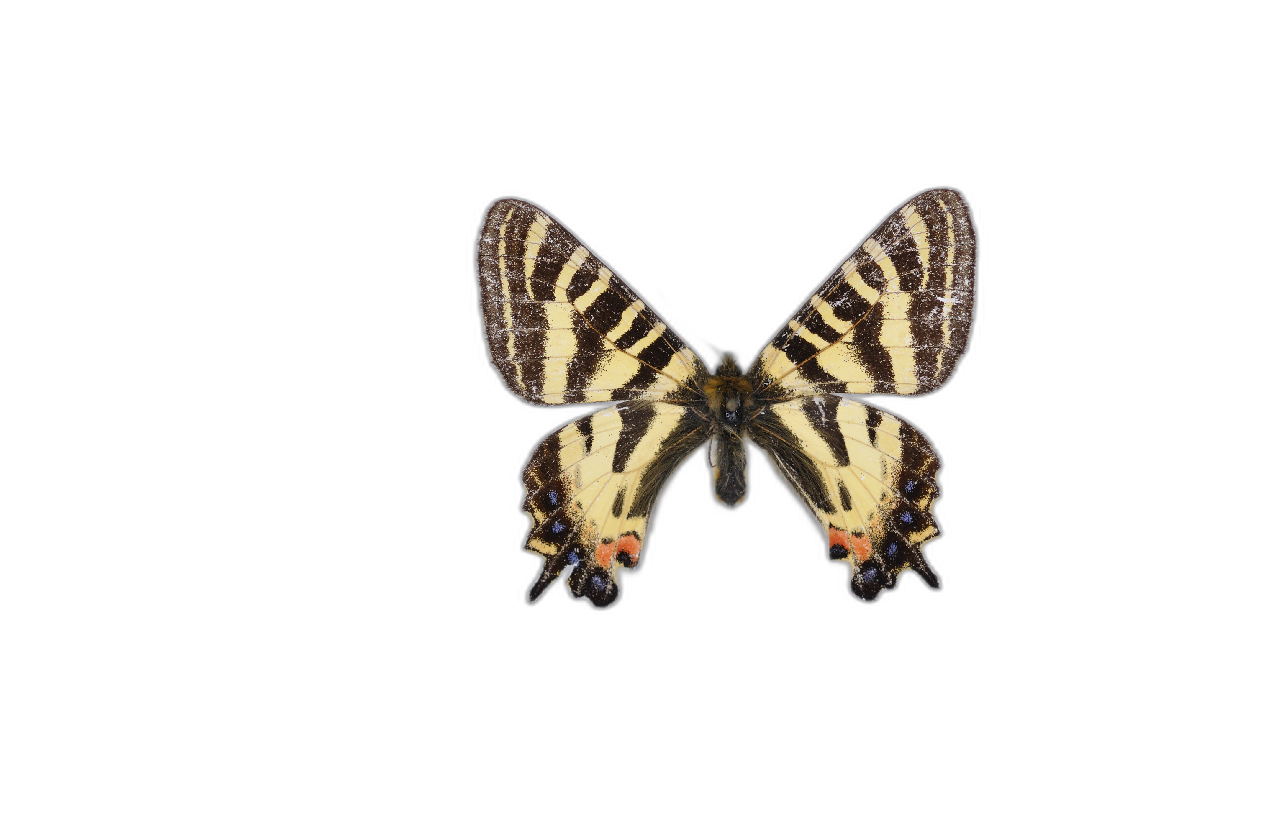
Objectives
Goal : quantify colour pattern similarity
Freedom from shape variation
Obtain a relative distance measure between all colour patterns
Notes:
Développement de la méthode de quantification

Slide 3
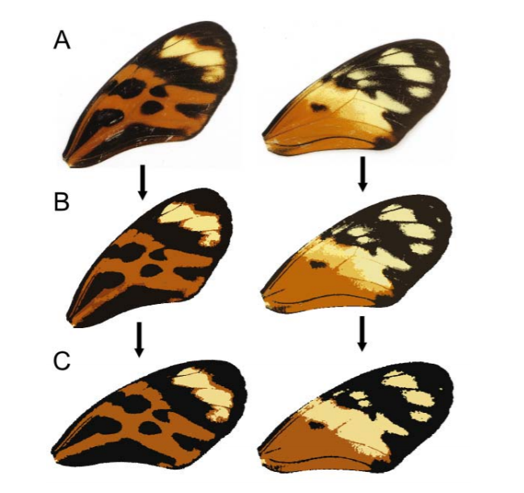
Quantification methods
Homology based methods: CPM, patternize
Notes:
Développement de la méthode de quantification

Slide 4

Quantification methods
Homology based methods: CPM, patternize
Pixel precise quantification and visualisation of variation
Notes:
Développement de la méthode de quantification

Slide 5

Quantification methods
Homology based methods: CPM, patternize
Pixel precise quantification and visualisation of variation
Alignment necessary, colour segmentation step
Notes:
Développement de la méthode de quantification

Slide 6
Quantification methods
Homology based methods: CPM, patternize
Pixel precise quantification and visualisation of variation
Alignment necessary, colour segmentation step
Machine learning based methods
Notes:
Développement de la méthode de quantification

Slide 7

Quantification methods
Homology based methods: CPM, patternize
Pixel precise quantification and visualisation of variation
Alignment necessary, colour segmentation step
Machine learning based methods
« Black box », no complete control over shape variation, need for labels
Notes:
Développement de la méthode de quantification

Slide 8
Quantification methods
Homology based methods: CPM, patternize
Pixel precise quantification and visualisation of variation
Alignment necessary, colour segmentation step
Machine learning based methods
« Black box », no complete control over shape variation, need for labels
Large scale colour pattern comparison possible, no bias in colour segmentation
Notes:
Développement de la méthode de quantification

Slide 9
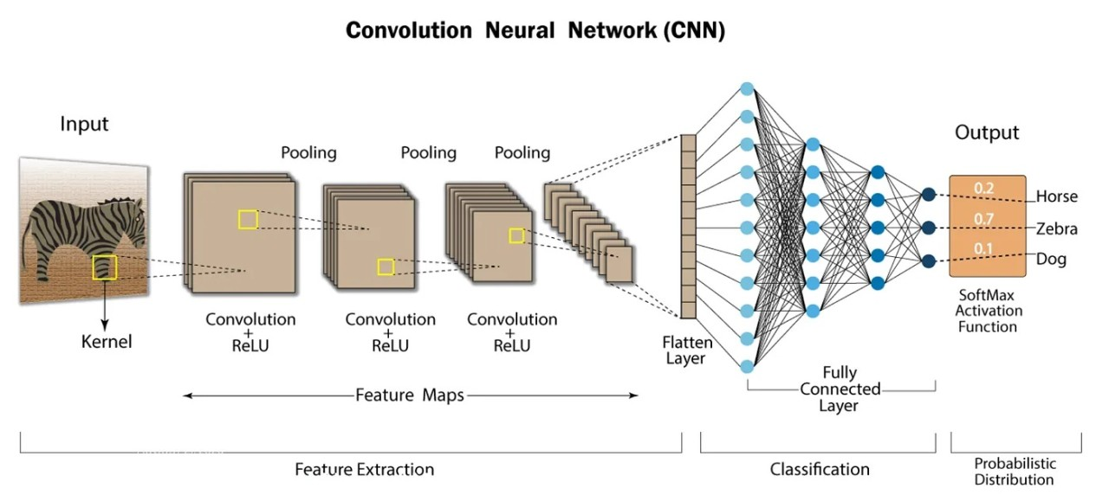
Convolution filters

Slide 10
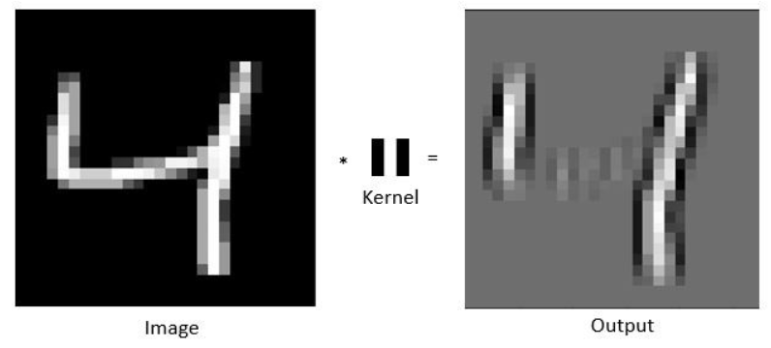
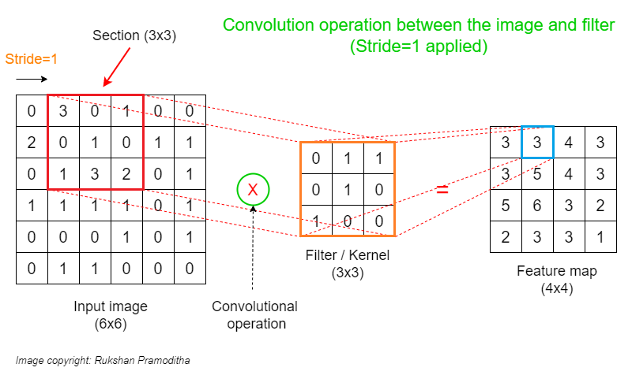
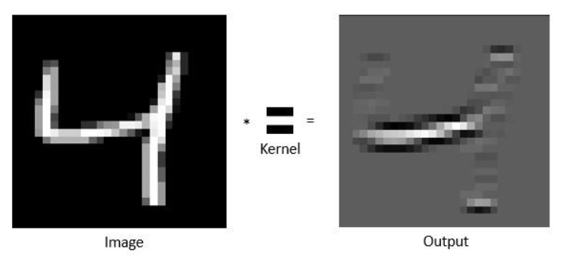
Convolution filters

Slide 11
« Neuron »

Slide 12
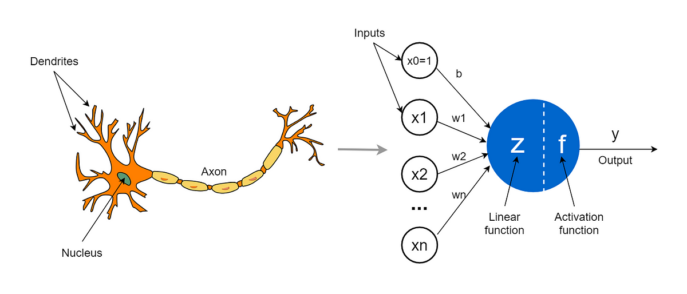
« Neuron »

Slide 13
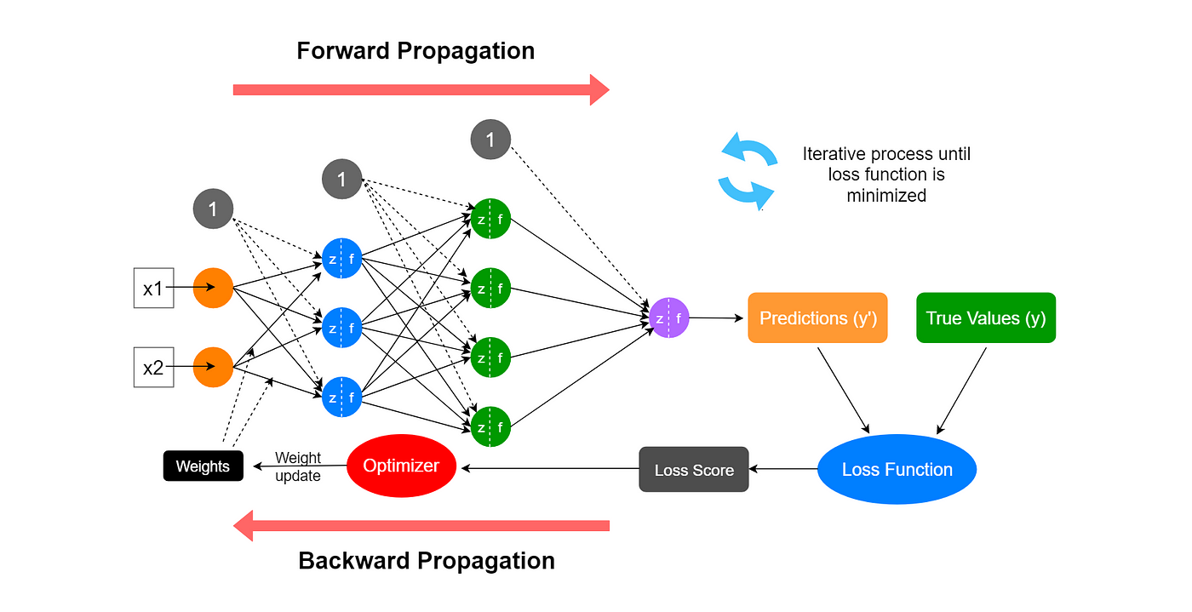
Neural network

Slide 16
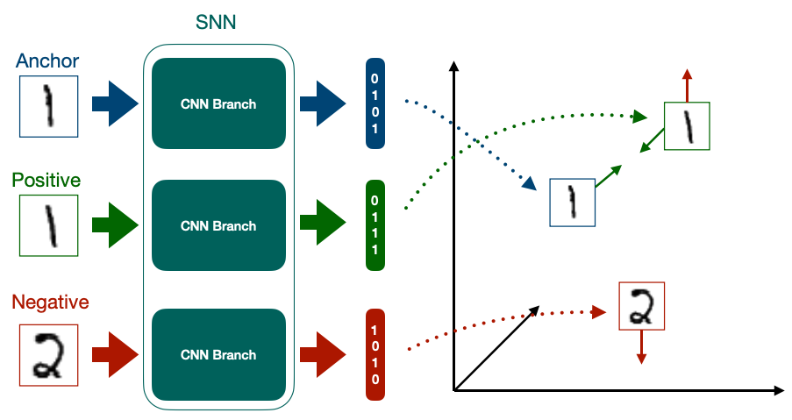
Discriminative
Metric learning
Siamese network

Slide 17
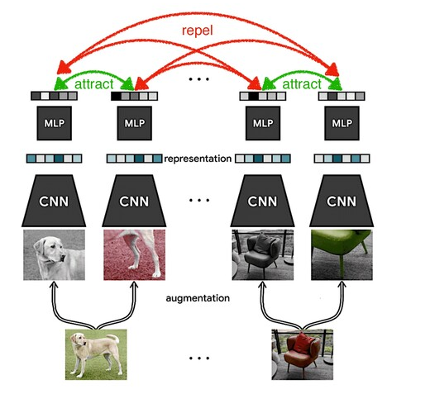
SimCLR a Simple Framework for Contrastive Learning of visual Representations
Chen, Ting, Simon Kornblith, Mohammad Norouzi, et Geoffrey Hinton. « A Simple Framework for Contrastive Learning of Visual Representations ». arXiv:2002.05709 [cs, stat], 30 juin 2020. http://arxiv.org/abs/2002.05709.
Self supervised learning
Crucial choice of augmentations
Relative distance latent space

Slide 18
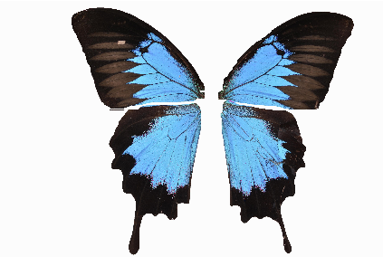
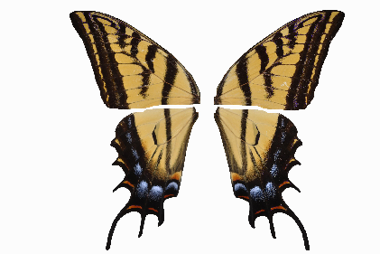

Slide 19
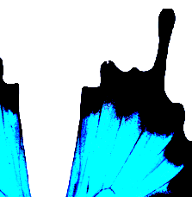
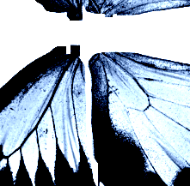
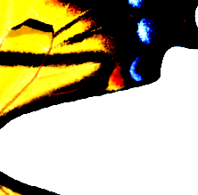
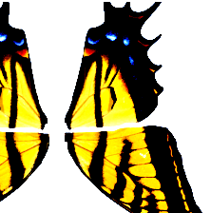
Crop
Rotations
Flipping
Shape-based augmentations
Grayscale
ImageNet normalization
No other colour augmentations
For pattern recognition

Slide 20
Anchor
Positive
Negative

Slide 21
Anchor
Positive
CNN
Negative

Slide 22
Anchor
Positive
ResNet-50
PRETRAINED
Negative

Slide 23
Anchor
0101
Positive
ResNet-50
0111
Negative
1010

Slide 24
Anchor
0101
Positive
ResNet-50
0111
Negative
1010

Slide 25
Anchor
0101
Positive
ResNet-50
0111
Negative
1010
XNT-Loss

Slide 26
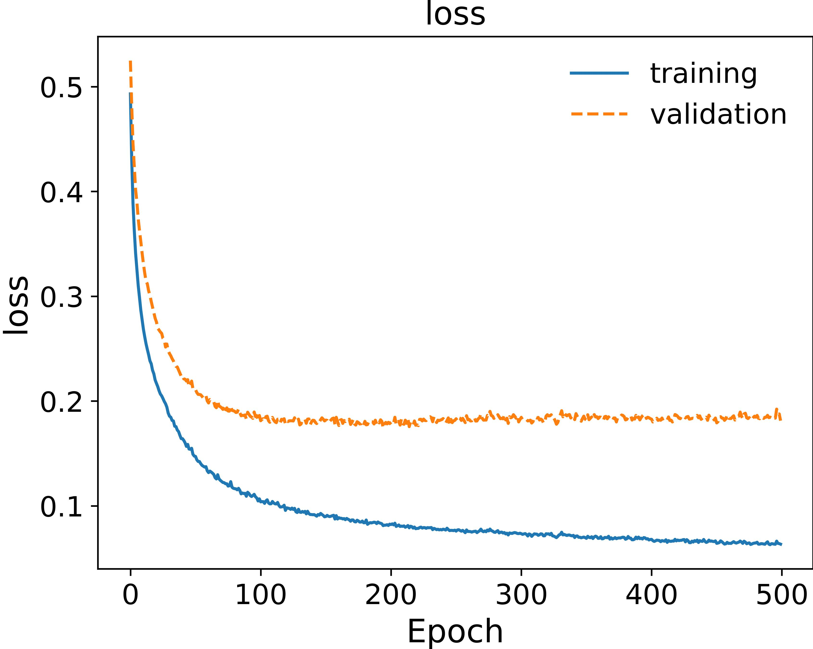
Model hyperparameters and model training
Hyperparameters: parameters that the user has to set
Temperature: a parameter within the loss function that controls the strength of repelling and attracting
Batch size: number of images fed to the neural network each epoch, from which negative examples are found (the larger, the better)
Epoch number: duration of the training
Model architecture: Resnet50 in our case, set from the SimCLR article but could be changed

Slide 27
What about model validation ?
Ground truth and hyperparameters

Slide 28
Hyperparameters
ResNet-50
Temperature Batch size Epoch number
?
?
?
Evaluation using a « pretext » task such as classification
What do we use as labels ?

Slide 29
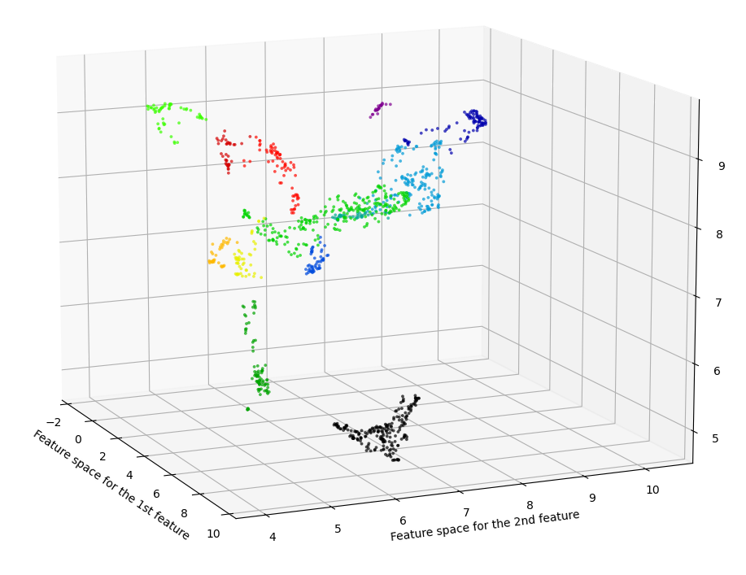
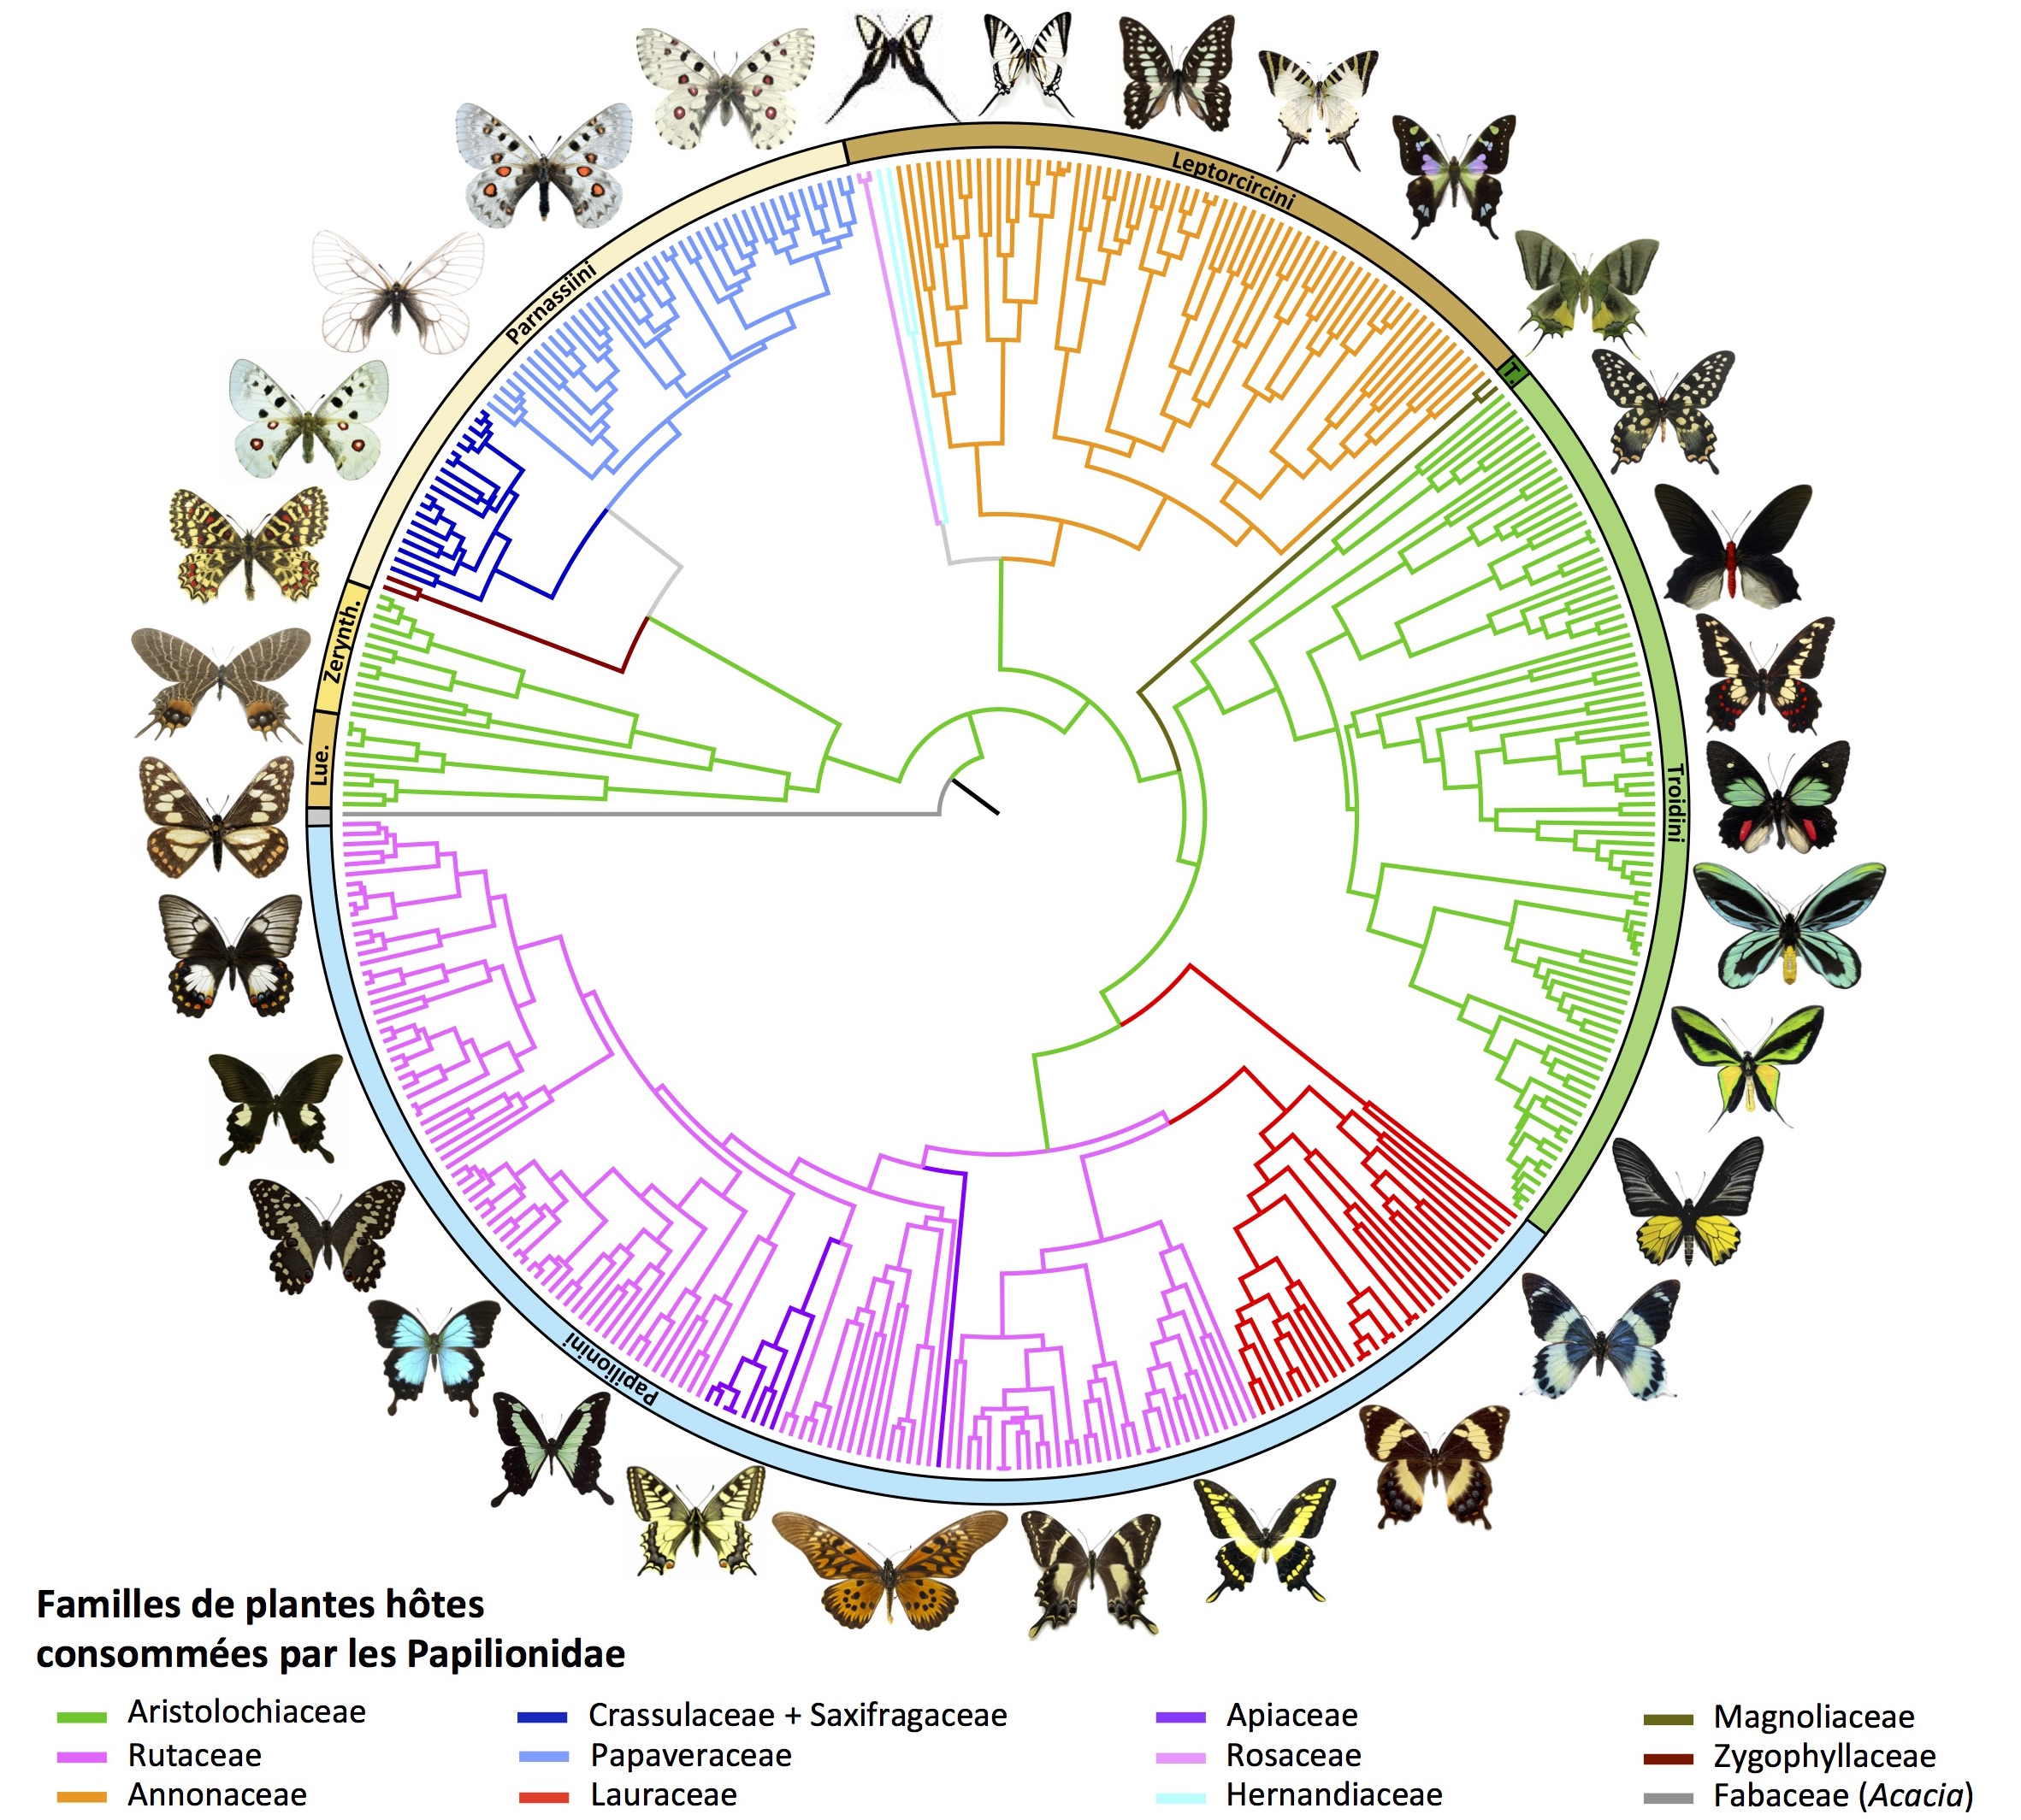
Hyperparameters
ResNet-50
Temperature Batch size Epoch number
?
?
?
Evaluation using a « pretext » task such as classification
Phenotypic clusters
Genus

Slide 30
Unsupervised training
SimCLR
Labels
FROZEN
No weights modification
Features
Classifier
Supervised model evaluation
Accuracy
+ other measures

Slide 31
SimCLR
Base model
« Null » model
Unsupervised training
SimCLR
Resnet-50 pretrained
Resnet-50 pretrained
Labels
Features
Features
Features
Classifier
Classifier
Classifier
Accuracy
+ other measures

Slide 32
Hyperparameters
ResNet-50
Temperature Batch size Epoch number
0,5
128
300
Pretrained Resnet-50
Fine-tuned Resnet-50
SimCLR
F1 score : 0,97
Kappa : 0,96
Accuracy : 95 %
F1 score : 0,84
Kappa : 0,81
Accuracy : 84 %
F1 score : 0,88
Kappa : 0,86
Accuracy : 87 %

Slide 33
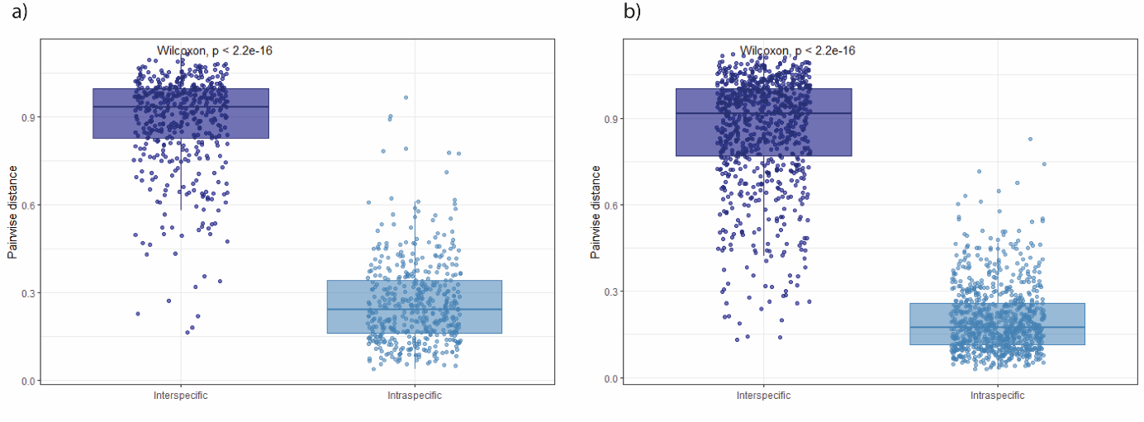
Inter vs intraspecific phenotypic distance
Males
Females
At the genus level as well

Slide 34
Visualisation
Explainability

Slide 35
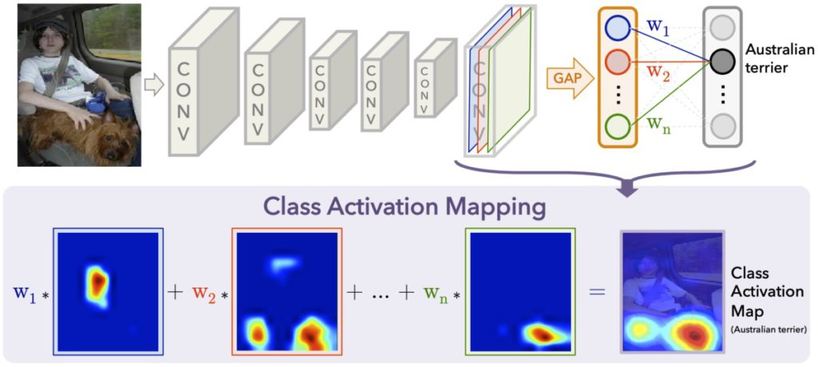
Grad-CAM

Slide 36
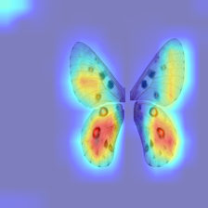
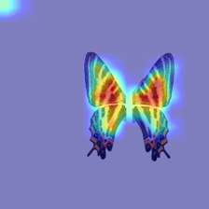
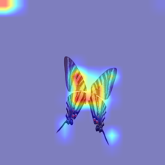
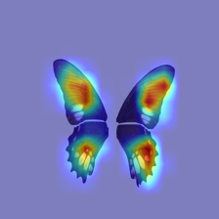
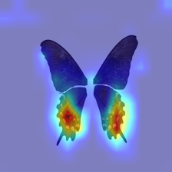
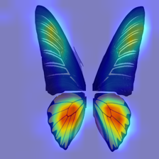
Grad-CAM

Slide 37
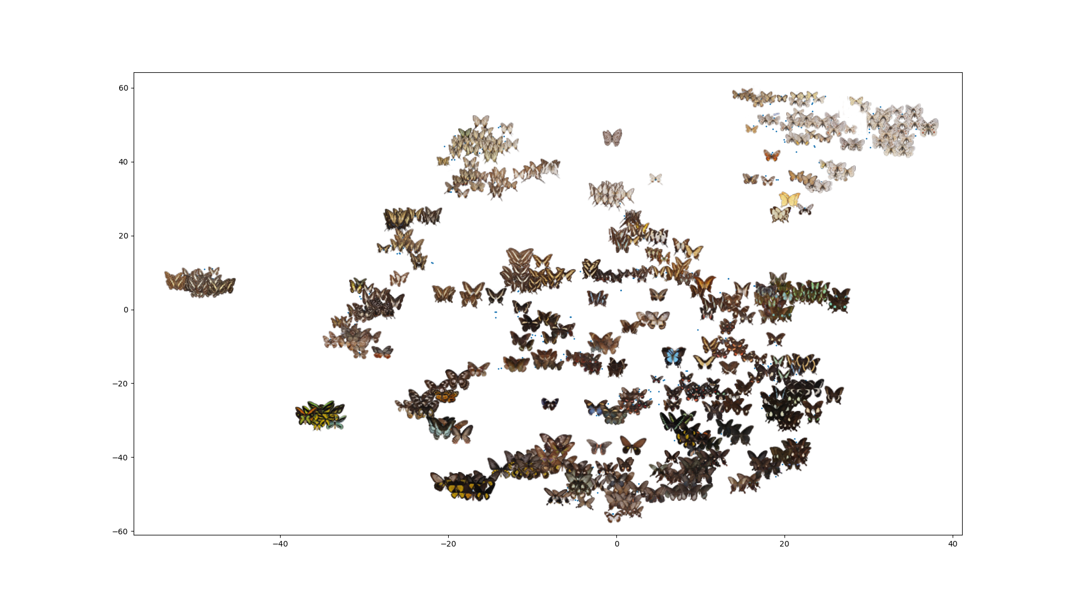
Morpho space
TSNE
Notes:
Premières analyses + idées ?

Slide 38
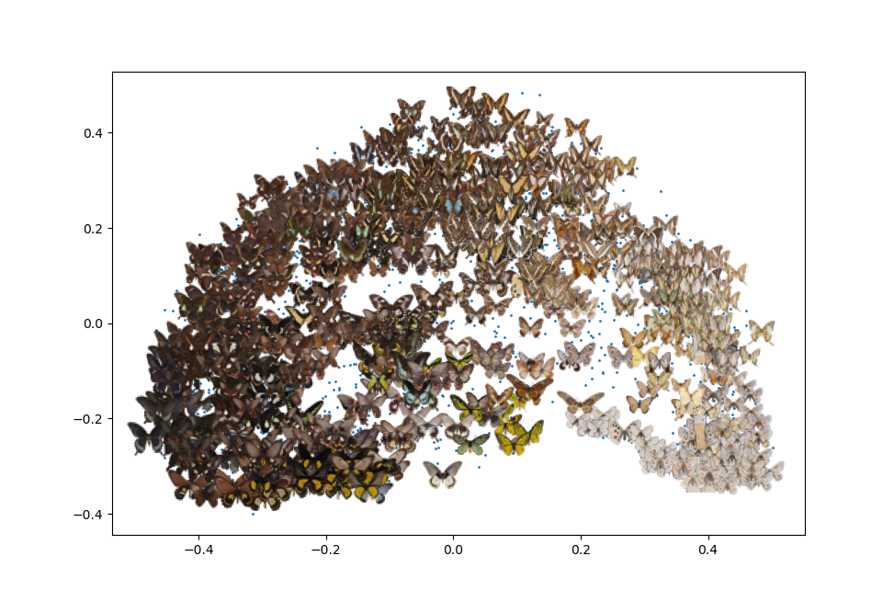
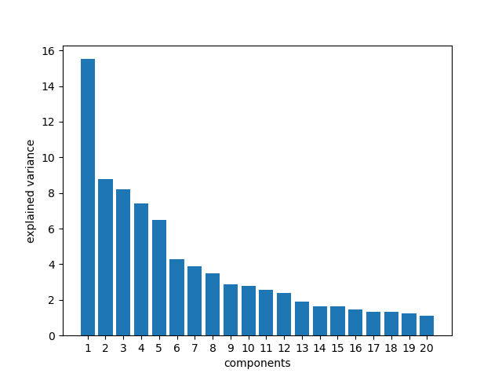
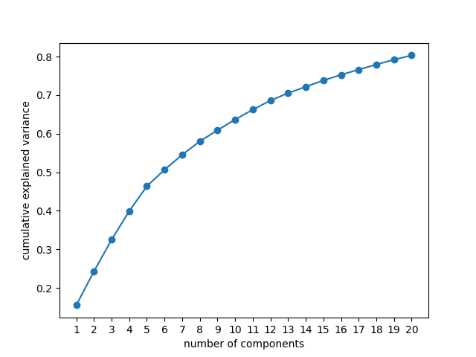
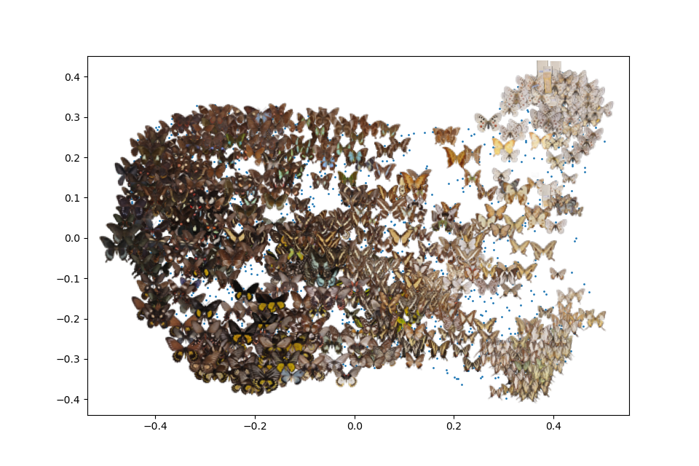
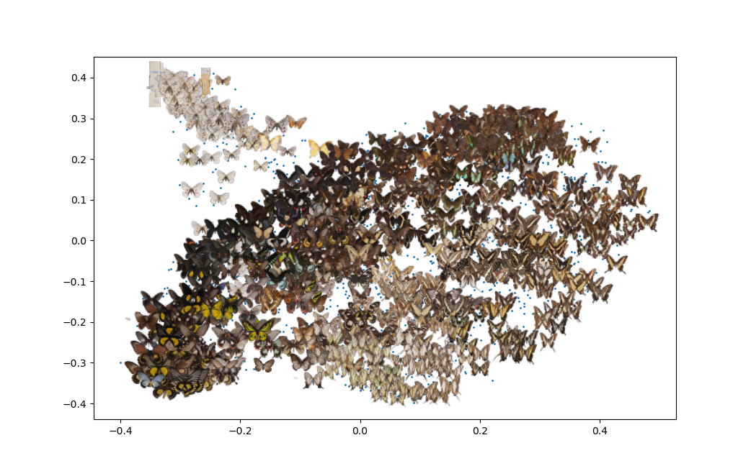
Morpho space
ACP
ACP
2048
20 -
~80%
PC2
PC1
PC3
PC3
PC1
PC2

Slide 39
The code

Slide 40

On my github (https://github.com/AgathePuissant), download the code « SimCLR_GUI.py » from the XXX project. It may be updated if I implement or correct errors.
The code contains:
Model training
Generating embeddings from a trained model
Model validation
GradCam visualisation
Wrapped in a GUI. It can be modified as needed in your local copy.
Separately to run in anaconda console: Scatterplot visualisation of the images

Slide 41
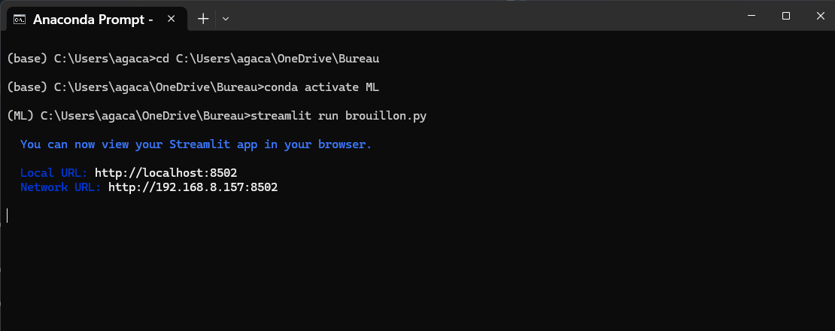
To run the code :
Open « Anaconda prompt », and change the directory to the one containing the .py file (type cd path/to/directory)
If needed, load the environment containing the packages (type conda activate nameofenvironement
conda install spyder
pip install -r requirements.txt
Type « streamlit run file.py » and it should open a webpage.

Slide 42
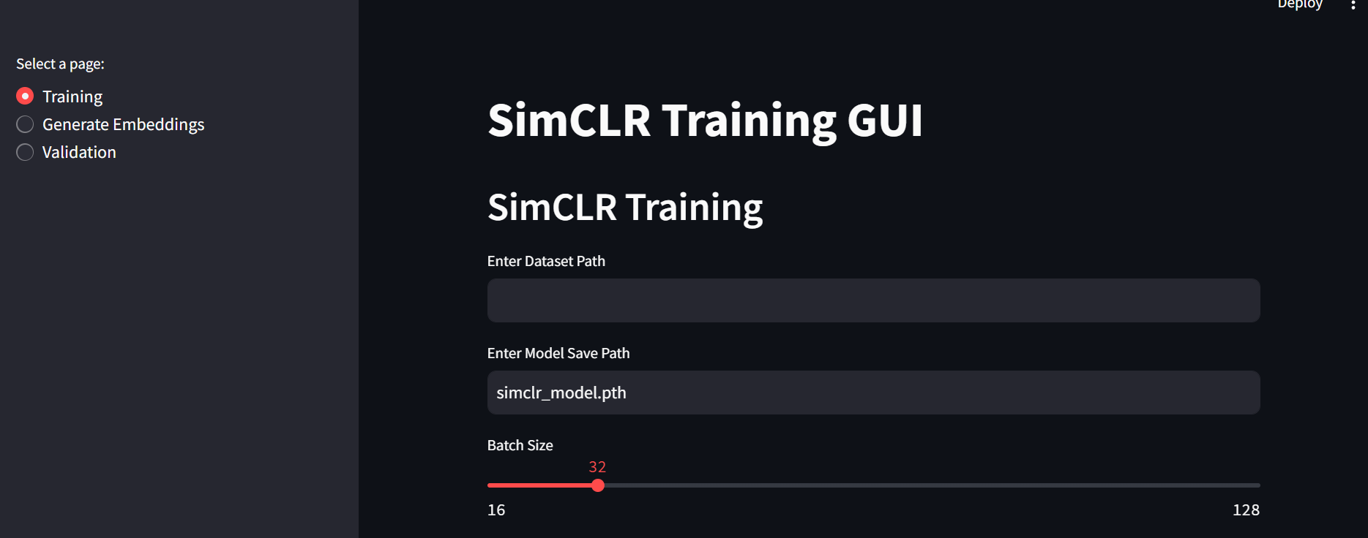
Slides for each part of the code

Slide 43
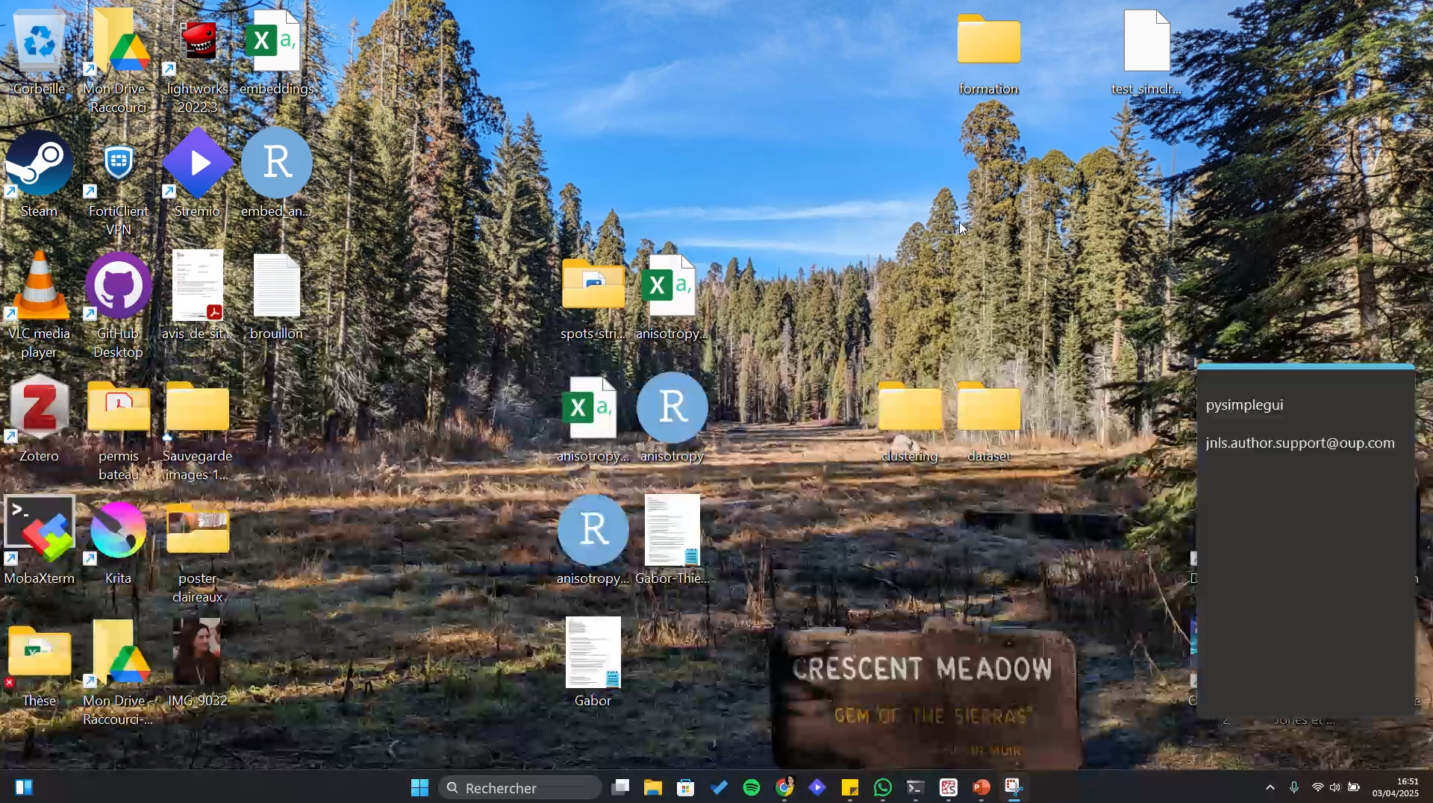
Dataset format
A folder, containing either the images directly, or folders corresponding to image labels for dataset balancing and/or validation.

Slide 44
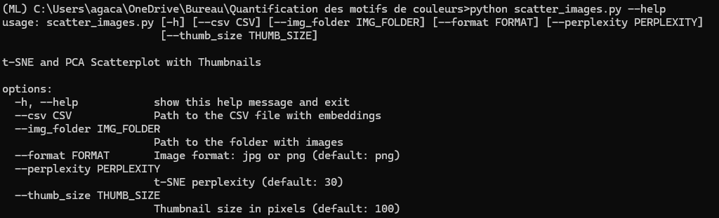
Large batch size means more GPU memory needed and often results in slower code, but generally leads to better results with SimCLR.
Scatter plot with images

